Slide 1



Android
By: Vincent Nagel

Slide 2
Outline
What is Android?
Why Android?
Core Concepts
App Demo

Slide 3
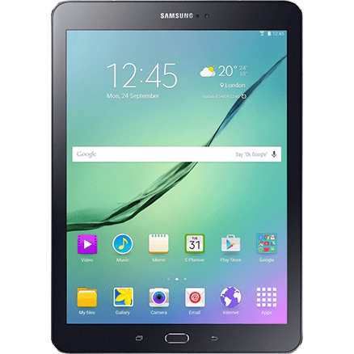
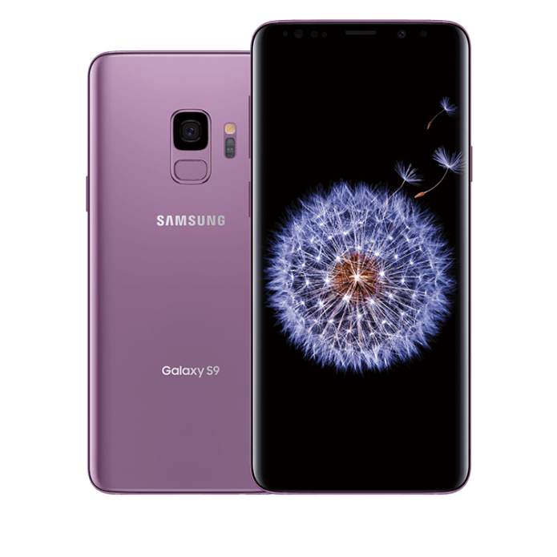
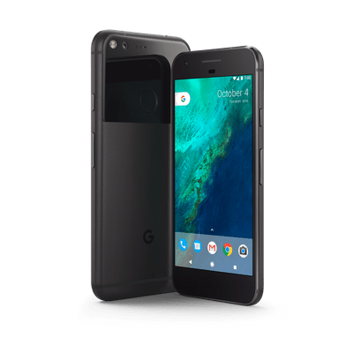
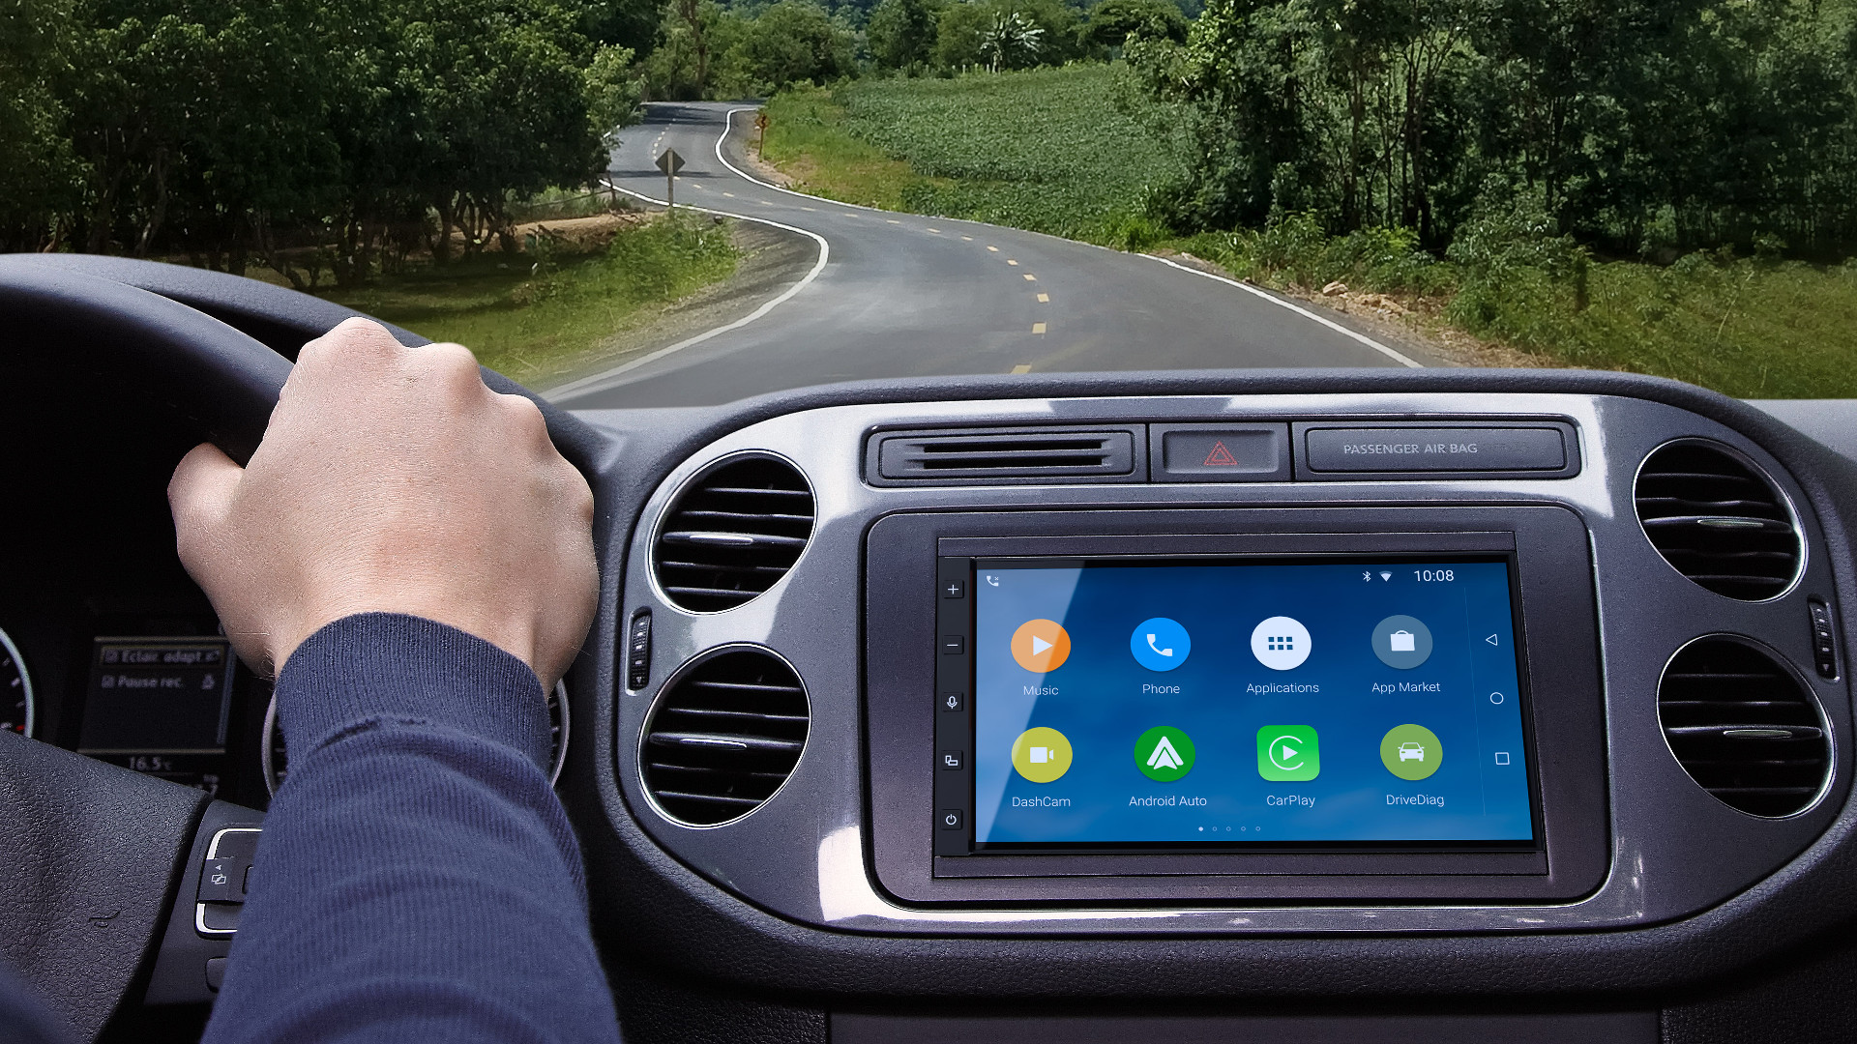

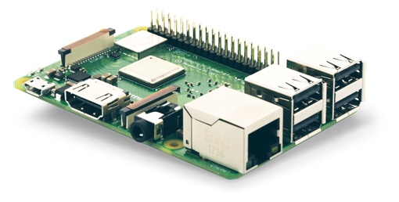
What is Android?
Mobile operating system
Developed by Google
Based on Linux kernel
Designed primarily for phones and tablets
Android Things, Android Auto, Wear OS, Chrome OS, and more!
Notes:
Android uses Linux Kernel for:
Threading
Low-level memory management
Security features
Well-known, so allows device manufacturers to develop hardware drivers easily
Also runs on consoles like Nvidia Shield, Android TV

Slide 4



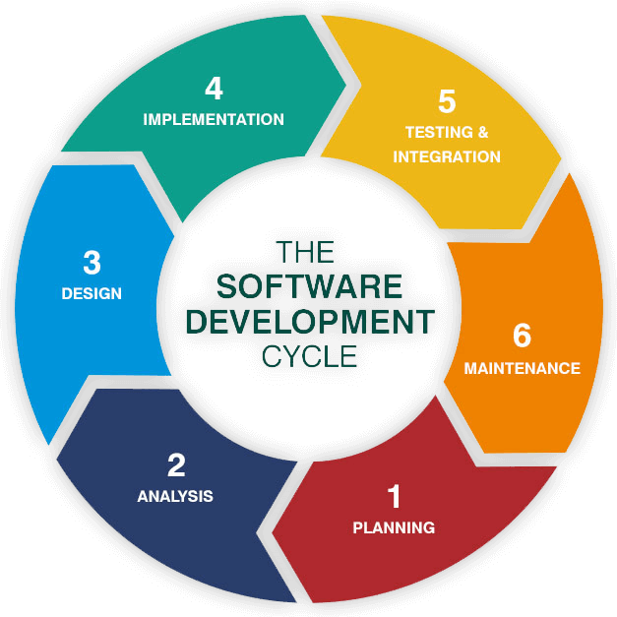
Why Android?
Learn valuable, transferrable skills
Java – one of the most widely-used programming languages
UX/UI
Databases
Software development life cycle
Software Development Life Cycle
Variety of opportunities
Android Things, Android Auto, Wear OS, Chrome OS, and more!
Low barrier to entry
Put as many apps on Play Store forever for only $25!
Notes:
Can write C/C++ if you want!
Native Android libraries
Performance-critical sections of the app
Kotlin
New official Android programming language since 2017
Integrates well with Java
Java can call Kotlin code and vice-versa
Concise

Slide 5
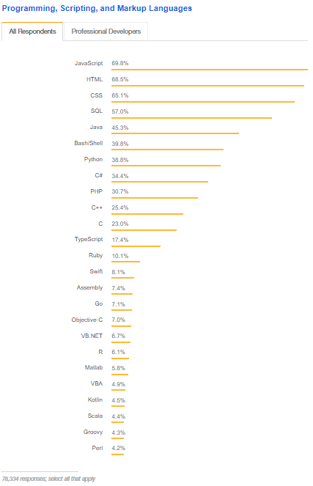
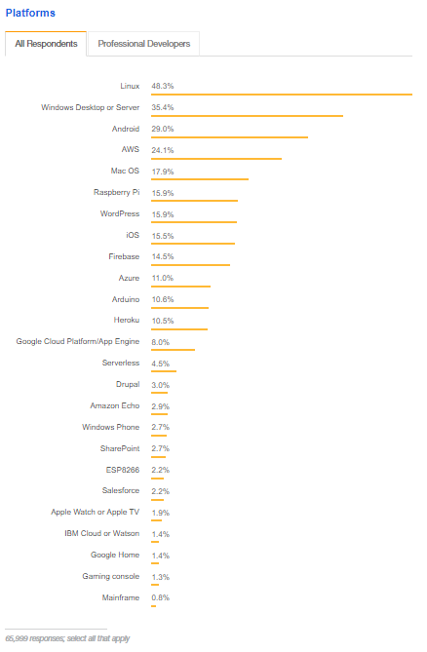
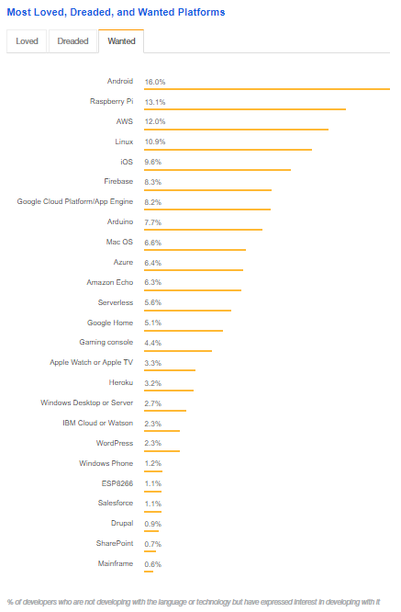
Why Android?
1!
3
5
22
Notes:
2018 StackOverflow survey of over 100,000 developers
Java is 5th most used programming language
Android is 3rd most commonly used developer platform
Android is 1st most wanted platform to develop on
https://insights.stackoverflow.com/survey/2018/#community

Slide 6
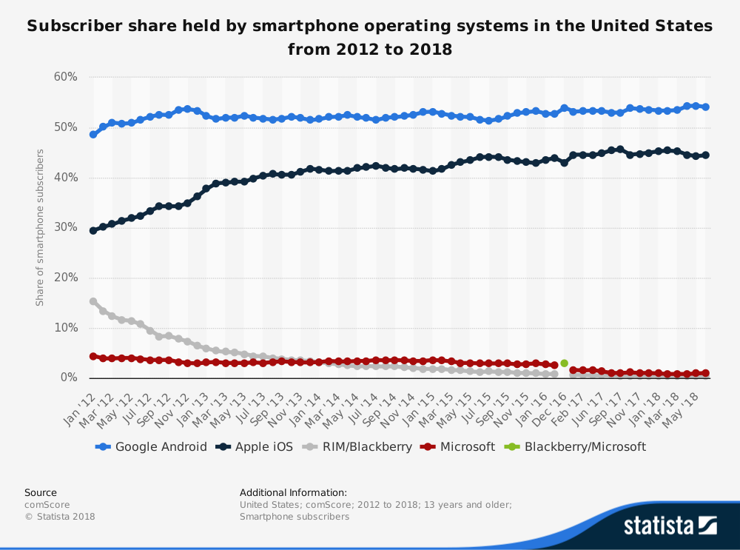
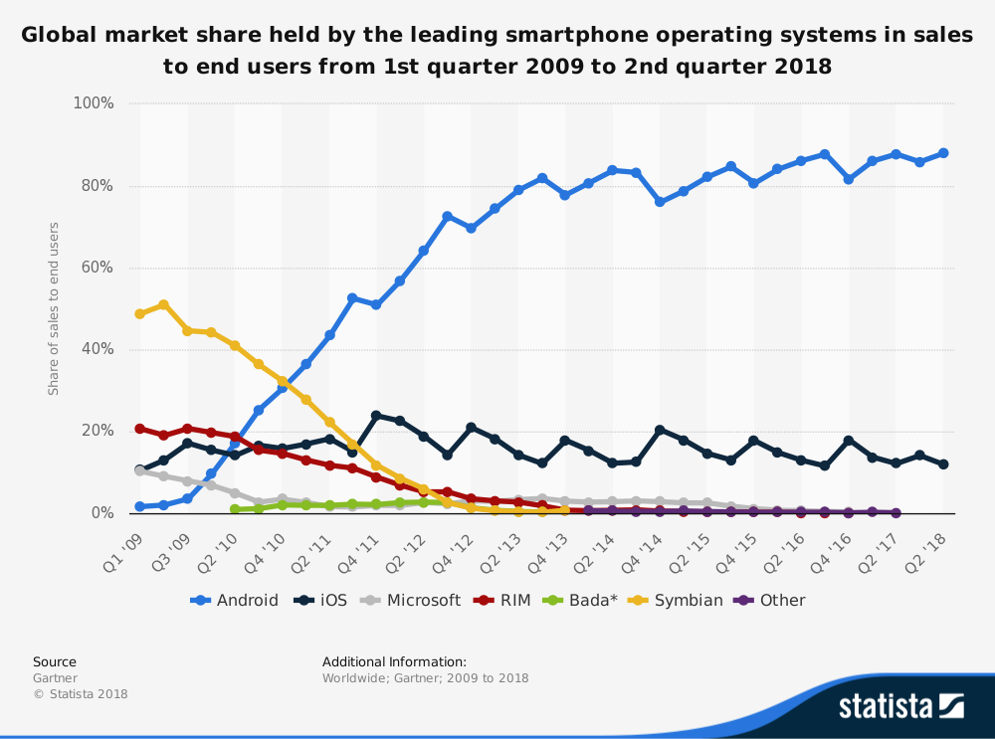
Why Android?
Most popular mobile platform in the US
and worldwide!
Notes:
https://www.statista.com/statistics/266572/market-share-held-by-smartphone-platforms-in-the-united-states/
https://www.statista.com/statistics/266136/global-market-share-held-by-smartphone-operating-systems/

Slide 7
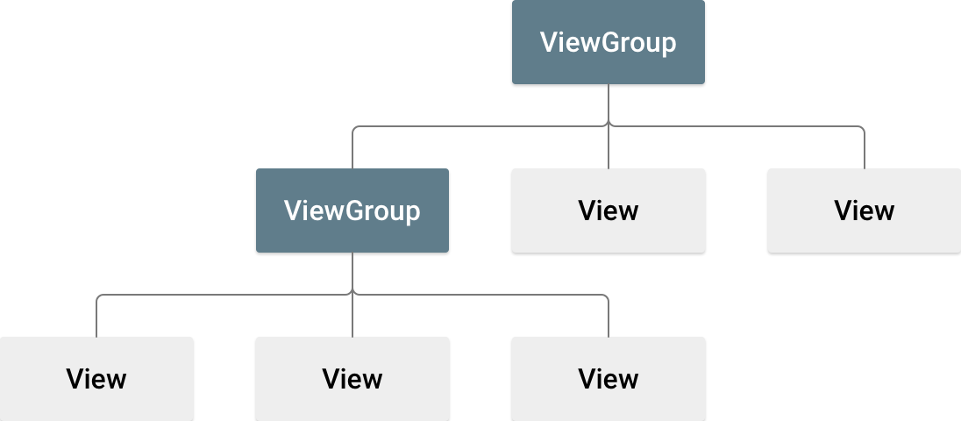
Core Concepts: Views and ViewGroups
View
ImageView, TextView, Button, Spinner, CalendarView
ViewGroup
ConstraintLayout, FrameLayout, LinearLayout, RelativeLayout, ListView, GridView, ScrollView, Toolbar
View
Base class for all UI components
Arranged in a tree
Created in Java code or layout XML files
ViewGroup
Special view that can contain other views
Base class for layouts and containers
Define the organization of child views
Notes:
View
All UI objects are View objects
Responsible for drawing and event handling
All views in a window are arranged in a single tree
Subclasses can display text, images, buttons, etc.
XML files define the layout for the activity’s UI
Java files define the logic

Slide 8
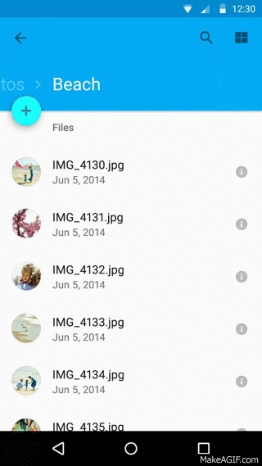
Core Concepts: Activities
Window in which the app draws its UI
One activity implements one screen
App does not always begin in same activity
Activities can start other activities
Managed with an activity stack
Notes:
App does not always begin in same activity
e.g. email app
open from you home screen and you might see a list of emails
launched from a social media app and you might go directly to composing an email
Activities can start other activities
e.g. on profile page and click settings button -> starts settings activity
Managed with an activity stack
When a new activity is started, it is placed on the top of the stack and becomes the running activity -- the previous activity always remains below it in the stack, and will not come to the foreground again until the new activity exits.

Slide 9
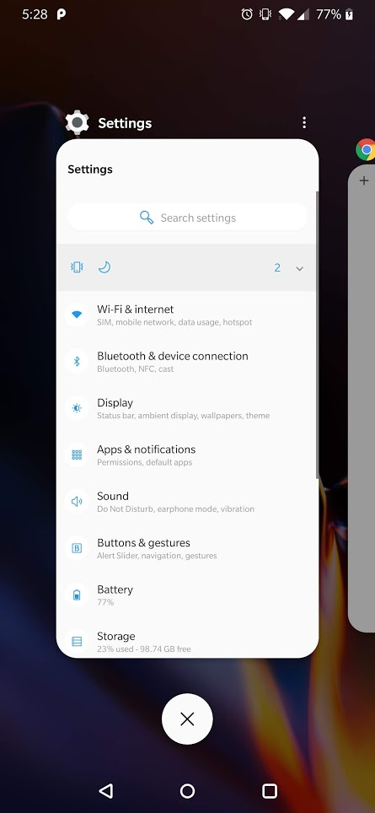
Core Concepts: Activity States
Active
In the foreground
Top of activity stack
Keep alive at all cost!
Paused
Out of focus, but still visible
Can be killed if extremely low on memory
Stopped
Completely covered by another activity
Often killed when memory is needed
Killed
Must be completely restarted to display again
Notes:
Killed
Usually need to take measures to ensure that you restore activity to its previous state

Slide 10
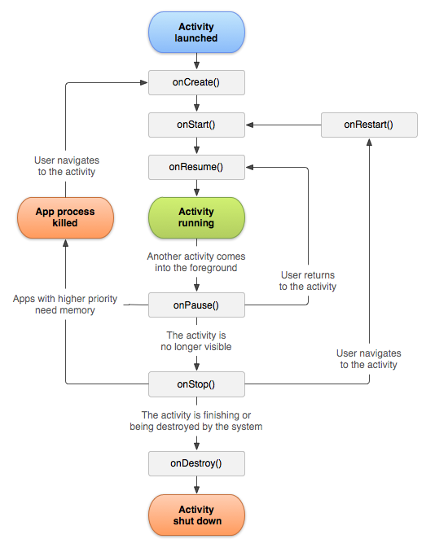
Core Concepts: Activity Lifecycle
onCreate(): Activity is first created
onStart(): Activity becomes visible to user
onResume(): User can interact with activity
onPause(): Activity out of focus
onStop(): Activity is no longer visible
onRestart(): Restore state of activity if necessary
onDestroy(): Final callback
Notes:
onCreate()
Analogous to main()
Must be implemented
Where you initialize essential components e.g. views
Where you call setContentView()
loads all UI components using XML files
onStart()
Final preparations for coming to foreground and becoming interactive
onResume()
Activity is at top of activity stack
Where most core functionality of app is implemented
onPause()
e.g. when user taps recent button or when dialog box shows
Activity still partially visible
Where you save persistent data
onResume() if activity comes back to front
onStop() if activity becomes hidden
onStop()
e.g. activity is being destroyed or new activity is starting
onRestart() if activity is returning to front
onDestroy() if activity is completely terminating
onDestroy()
ensure all resources are released
NOT where you save persistent data

Slide 11
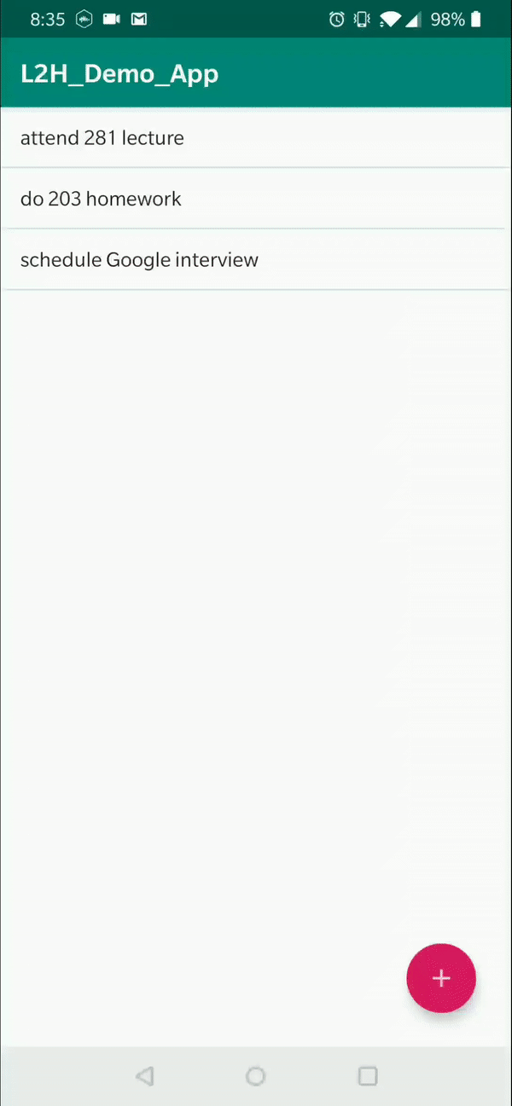
App Demo: To-do List
Features
Add items
Remove individual items
Remove all items
Notes:
Navigation pane
Android
simple and convenient
Project
shows actual file structure on computer
java directory
Contains all your java files
Define most of the dynamic functionality of your app
res.layout directory
Contains all your layout xml files.
Define the structure for the UI
Provides a GUI to preview the UI and easily edit Views and ViewGroups
Built using a hierarchy of View and ViewGroup objects
View: usually draws something the user can see and interact with
ViewGroup: invisible container that defines the layout structure for View and other ViewGroup objects
Location of project on computer at top
“Run” tab used to run and debug the app
MainActivity usually first when user opens app
ArrayAdapter converts an ArrayList of objects into View items loaded into the ListView container.
onLongClick() - This returns a boolean to indicate whether you have consumed the event and it should not be carried further. That is, return true to indicate that you have handled the event and it should stop here; return false if you have not handled it and/or the event should continue to any other on-click listeners.

Slide 12
Resources
developer.android.com/guide
Codelabs
Free online courses
Documentation
YouTube
The New Boston, Slide Nerd, Android Developers, Derek Banas
Other
Android Hive, Tutorials Point, Vogella
github.com/JStumpp/awesome-android
Huge curated list of Android libraries and resources
Notes:
developer.android.com
You can count it on to be up to date
The rest are good, though you will often find a good one just by Googling your problem.
DON’T just copy and paste code from StackOverflow or blog posts without knowing what they are doing.

Slide 13
Thank you!
Check out the Android team! github.com/michiganhackers/androidapp
StackOverflow survey: insights.stackoverflow.com/survey/2018/#community

